Slide 1
Decoding Food Waste: Insights from Visual Analytics
Yashwwanth Krishna Popuri

Slide 2

Problem and Its Importance
Problem: Global food waste reaches approximately 1.3 billion tons annually, posing significant economic, environmental, and social challenges.
Importance of the Problem: Addressing food waste can significantly reduce hunger, save costs, and minimize environmental impact, making it a critical issue globally.
References:
FAO, 2019: The State of Food and Agriculture
UNEP Food Waste Index Report 2021
Reducing Food Loss and Waste by World Resources Institute.

Slide 3
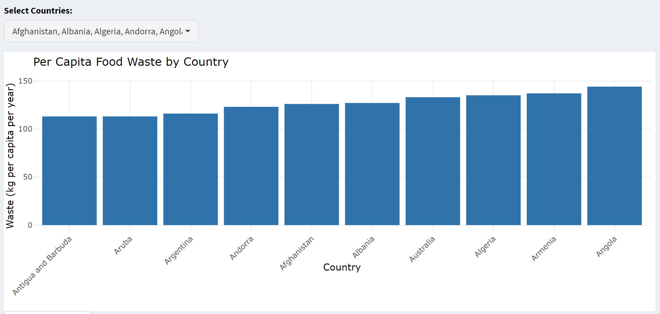
Utilizing Visual Analytics for Food Waste Reduction
Description: This bar chart displays per capita food waste by country, helping stakeholders quickly identify high-waste contributors for targeted interventions.
Application: Policymakers and organizations can use this data to prioritize countries for food waste reduction programs, adjusting policies and resources to where they are needed most.

Slide 4
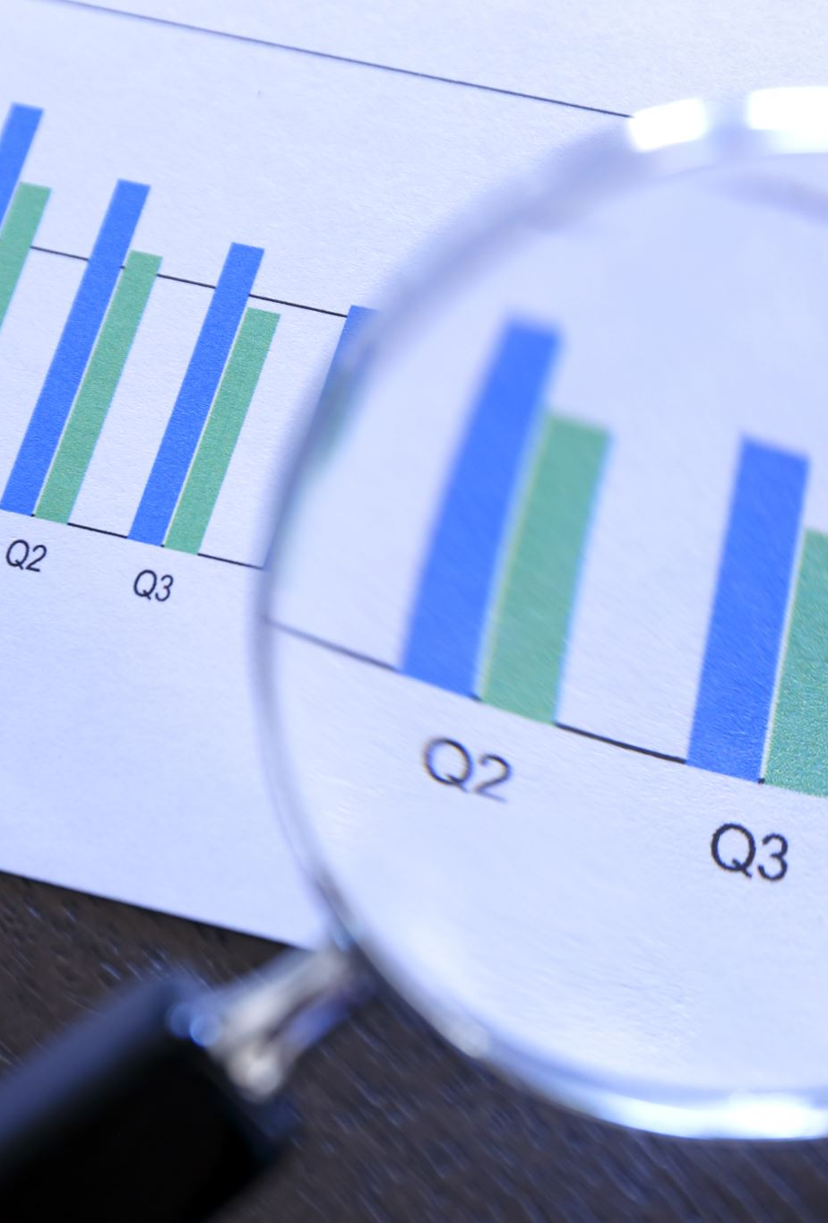
HCD Empathize: Community Insights on Food Waste Reduction
Aim: To minimize food waste by analyzing public data and user insights, using R Shiny visualizations to pinpoint and address key waste areas.
User Interviews: Conducted detailed interviews with consumers, businesses (including insights from a relative who owns a restaurant and a vegetable store), to gather qualitative insights.

Slide 5
HCD-Define
Why?
Why?
Why?
Needs:
To significantly reduce global food waste and its impacts.
Address economic, environmental, social challenges.
Optimize resource use and efficiency.
Improve global food security.
Prioritize high-waste areas using data.
Adjust policies, allocate resources effectively.
Raise awareness, engage all consumers.
How?
How?
How?

Slide 6
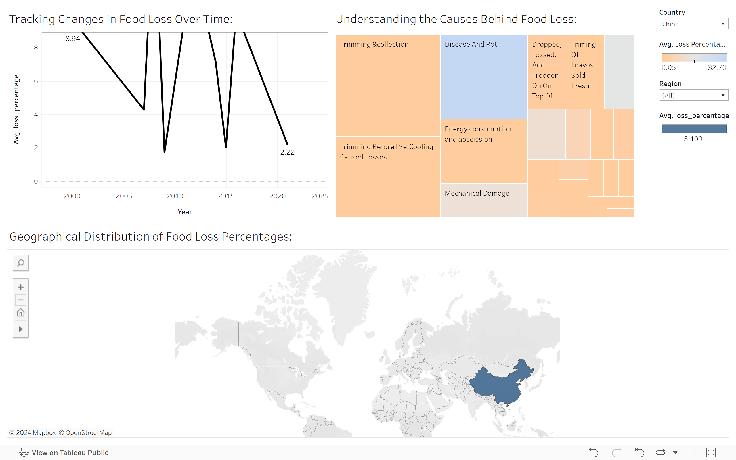
HCD - Ideate
Interactive Trend Analysis: Enhance the line graph with interactive features to allow users to examine specific time frames or regions, aiding in pinpointing critical changes in food loss.
Cause Exploration Tools: Make the treemap of food loss causes interactive, enabling users to access detailed information, strategies, and case studies for each category directly through the visualization.
Regional Focus: Incorporate clickable regions in the geographical distribution map to reveal localized data, policies, and success stories, fostering targeted analysis and interventions.
Customizable Data Queries: Add functionality for users to set specific data parameters, like selecting countries or adjusting loss percentages, to generate tailored reports and receive alerts for effective monitoring and action.

Slide 7
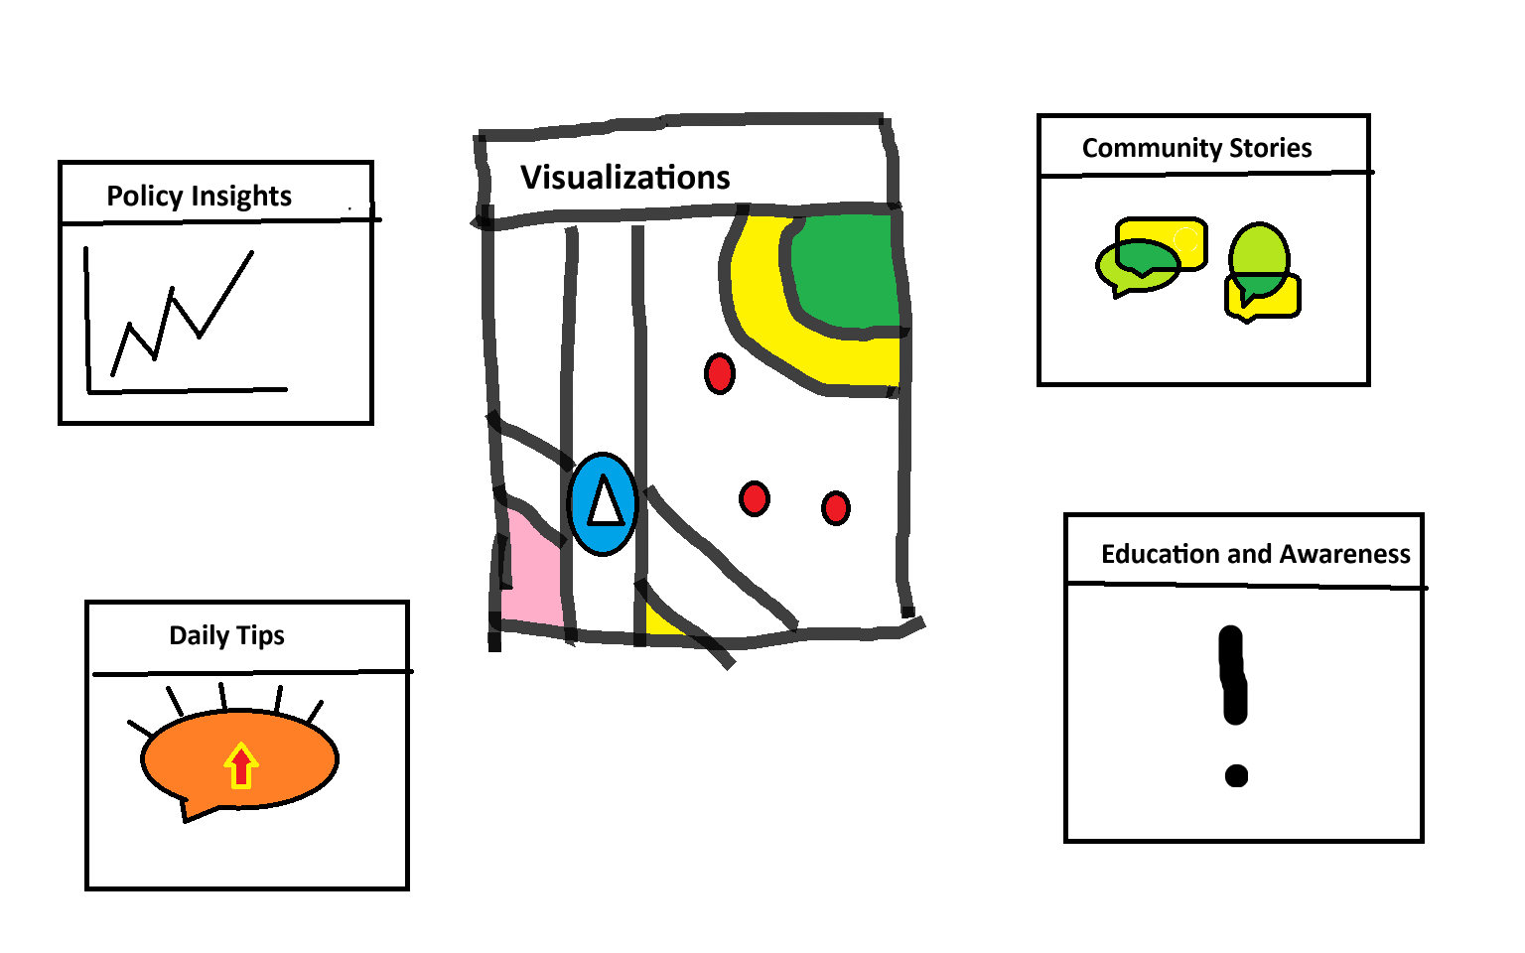
HCD - Prototype
Data Visualization and Insight: Integrates real-time data visualization to simplify complex food waste statistics for easy user understanding and informed policymaking.

Slide 8
HCD-Testing
Krishna Vamshi, owner of a restaurant and a vegetable store, provided essential feedback during the human-centered design (HCD) testing phase of our food waste management application. His insights significantly shaped the app's development, particularly in enhancing features such as easy to understand visualization and user engagement content to suit the fast-paced nature of commercial settings.

Slide 9
Rshiny APplication

Slide 10
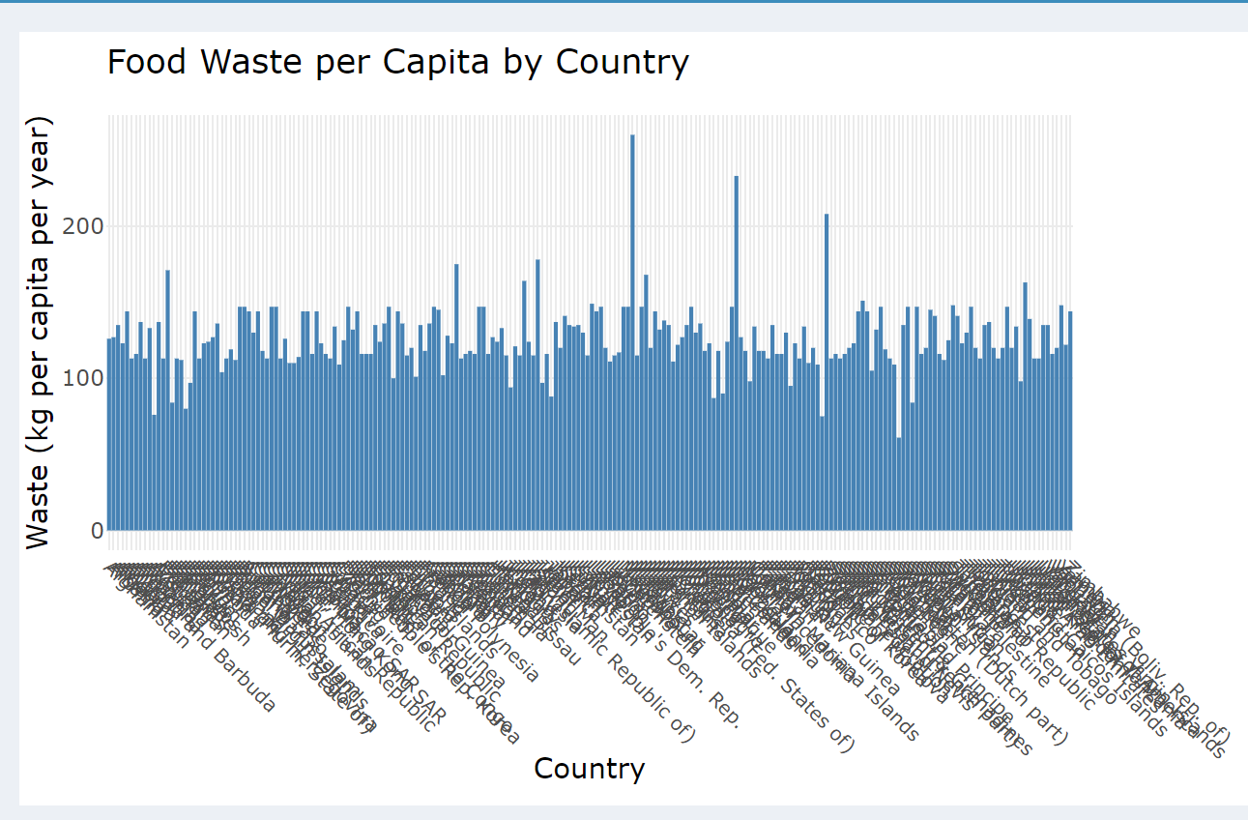
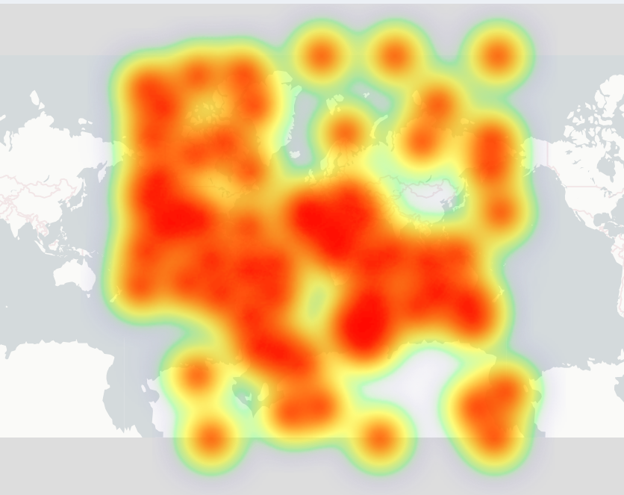
Atlernative Approaches:
1. Bar Chart of Food Waste per Capita by Country:
- The x-axis is overcrowded with country names, significantly reducing readability.
2. Heatmap on a World Map:
- It lacks the ability to provide precise numerical values, which is crucial for detailed data analysis.

Slide 11
Conclusions
This application revolutionizes how data is utilized in practice, enabling rapid and informed decision-making that can adapt to changing conditions effectively.
By providing clear, interactive visualizations, stakeholders can prioritize interventions, allocate resources more efficiently, and understand complex data at a glance.
This tool isn't just about displaying data—it's about empowering global initiatives, reducing inefficiencies, and making impactful decisions that can change the world.

